Slide 1

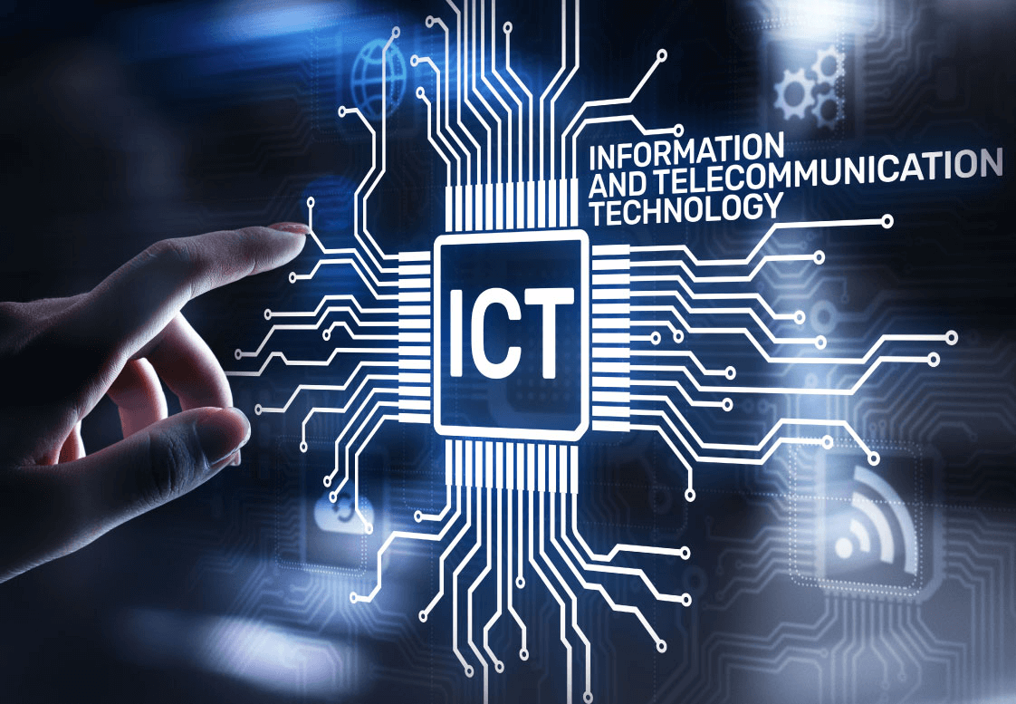

INFORMATION AND COMMUNICATION TECHNOLOGY

Slide 2







01
Introduction to ICT
02
Key Components of ICT
03
ICT in Business
CONTENTS
04
ICT in Healthcare
05
Challenges in ICT
06
Future Trends in ICT
07
Conclusion

Slide 3
Introduction to ICT
Information and Communication Technology (ICT) encompasses a wide range of technologies that facilitate the access, transmission, and storage of information. In today’s digital age, ICT plays a crucial role in connecting people, businesses, and institutions across the globe. It integrates telecommunications, computers, software applications, and various services to enhance communication and improve efficiency. Understanding ICT is essential as it shapes how we interact, learn, and conduct business, ultimately transforming our daily lives.

Slide 4
Key Components of ICT
The foundation of ICT comprises three key components: hardware, software, and telecommunications. Hardware includes devices such as computers, smartphones, and networking equipment that allow users to access and process information. Software refers to the applications and programs that enable users to perform tasks, from word processing to data analysis. Telecommunications involve the infrastructure that connects devices, including the internet, mobile networks, and satellite communications. Together, these components create an ecosystem that supports seamless information exchange and communication.

Slide 5
ICT in Education
ICT has revolutionized the educational landscape by providing innovative tools and resources that enhance learning experiences. E-learning platforms enable students to access courses and materials anytime, anywhere, fostering a more flexible learning environment. Remote learning technologies, such as video conferencing and collaborative tools, facilitate real-time interaction between educators and learners, breaking down geographical barriers. Additionally, digital resources, like online libraries and educational apps, support diverse learning styles and promote independent study, preparing students for a technology-driven world.

Slide 6
ICT IN BUSINESS
In the business realm, ICT is pivotal for improving operational efficiency and driving innovation. Companies leverage automation to streamline routine processes, reducing human error and increasing productivity. Communication tools, including emails, instant messaging, and video conferencing platforms, enhance collaboration among teams, regardless of location. Furthermore, data analytics enables businesses to harness large volumes of information for strategic decision-making, identifying trends and customer preferences. By integrating ICT into their operations, organizations can remain competitive and responsive to market changes.

Slide 7
ICT IN HEALTHCARE
The impact of ICT in healthcare is profound, leading to improved patient outcomes and enhanced efficiency in service delivery. Telemedicine allows healthcare professionals to consult with patients remotely, expanding access to care, especially in rural areas. Electronic Health Records (EHR) systems streamline the management of patient information, enabling better coordination among healthcare providers. Additionally, wearable health technology monitors vital signs in real-time, empowering patients to take charge of their health. The integration of ICT in healthcare not only improves service delivery but also enhances the patient experience.

Slide 8
CHALLENGES IN ICT
Despite its many benefits, ICT faces significant challenges that must be addressed to maximize its potential. Cybersecurity threats pose risks to data integrity and privacy, requiring organizations to invest in robust security measures. The digital divide remains a pressing issue, with disparities in access to technology and the internet hindering equitable participation in the digital economy. Furthermore, the rapid pace of technological advancement necessitates ongoing training and education for individuals to keep up with emerging tools and platforms. Addressing these challenges is essential for a more inclusive and secure digital future.

Slide 9
FUTURE TRENDS IN ICT
The future of ICT is poised for transformative growth, driven by advancements in technology. Artificial Intelligence (AI) is becoming increasingly integrated into various applications, enhancing decision-making and automating processes across sectors. The Internet of Things (IoT) is expanding, connecting everyday devices to the internet and enabling smarter living environments. Additionally, there is a growing emphasis on digital literacy, equipping individuals with the skills needed to navigate and thrive in a tech-centric world. Embracing these trends will be crucial for individuals and organizations looking to leverage ICT for innovation and success.

Slide 10
CONCLUSION
In conclusion, Information and Communication Technology is a cornerstone of modern society, influencing how we communicate, learn, and conduct business. Its components work together to create a connected world, with profound implications for education, healthcare, and commerce. However, challenges such as cybersecurity risks and the digital divide must be addressed to fully harness its potential. By staying informed and adapting to technological advancements, we can embrace the opportunities that ICT presents, ultimately fostering a more connected, efficient, and equitable future.

